Slide 1
Database System
Saba Ghani
FAST-NU
Chiniot-Faisalabad campus

Slide 2
Week 2
Data models, Schema and Instances, Three-Schema architecture, Data Independence
Database languages and interface
Database users
The Database system Environment, Centralized and client/Server architecture for DBMSs.
Classification of DBMS

Slide 3
1. History of database applications
First-generation
Hierarchical and Network
Second generation
Relational
Third generation
Object-Oriented
Object Relational
Fourth generation
Interchanging Data on the Web for E-Commerce Using XML
Fifth generation
Emergence of Big Data Storage Systems and NOSQL Databases

Slide 4
1.1. Early Database Applications Using Hierarchical and Network Systems
Many early database applications-maintained records in large organizations such as corporations, universities, hospitals, and banks. In many of these applications, there were large numbers of records of similar structure. For example, in a university application, similar information would be kept for each student, each course, each grade record, and so on.
it did not provide enough flexibility to access records efficiently when new queries and transactions were identified. It was also laborious to reorganize the database when changes were made to the application’s requirements.
they provided only programming language interfaces. This made it time-consuming and expensive to implement
Era: starting in the mid-1960s and continuing through the 1970s and 1980s

Slide 5
1.2. Providing Data Abstraction and Application Flexibility with Relational Databases
Relational databases were originally proposed to separate the physical storage of data from its conceptual representation and to provide a mathematical foundation for data representation and querying.
introduced high-level query languages that provided an alternative to programming language interfaces
provided flexibility to develop new queries quickly and to reorganize the database as requirements changed. Hence, data abstraction and program-data independence were much improved when compared to earlier systems
Era: started in late 1970s

Slide 6
1.3. Object-Oriented Applications and the Need for More Complex Databases
The emergence of object-oriented programming languages in the 1980s and the need to store and share complex, structured objects led to the development of object-oriented databases (OODBs). Initially, OODBs were considered a competitor to relational databases.
However, the complexity of the model and the lack of an early standard contributed to their limited use.
They are now mainly used in specialized applications, such as engineering design, multimedia publishing, and manufacturing systems.
many object-oriented concepts were incorporated into the newer versions of relational DBMSs, leading to object-relational database management systems, known as ORDBMSs.

Slide 7
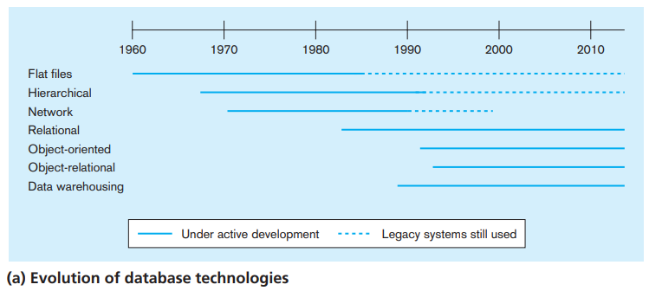

Slide 8
Data Models
A model is an abstraction process that hides details
Data model: A collection of concepts to describe the structure of a database, and certain constraints that the database should obey.
Data modeling is used for representing entities of interest and their relationship in the database.
The structure of a database includes data types, relationships, and constraints that should hold for the data.
Most data models also include a set of basic operations for specifying retrievals and updates on the database.
The data model specify dynamic aspects or behavior to specify valid defined users' operations.
For example: An example of a user-defined operation could be COMPUTE_GPA, which can be applied to a STUDENT object

Slide 9
Categories of data models
High-level or conceptual data models
provide concepts that are close to the way many users perceive data
Use Entity-Relationship(ER) Model
use concepts such as entities, attributes, and relationships.
An entity represents a real-world object or concept, such as an employee, project, student from the mini world
An attribute represents some property of interest that further describes an entity, such as the employee's name or salary.
A relationship among two or more entities represents an association among two or more entities, for example, a works-on relationship between an employee and a project.

Slide 10
Categories of data models
low-level or physical data model
provides concepts that describe the details of how data is stored in the computer model/storage media.
by representing information such as record formats, record orderings, and access paths
access path is a search structure that makes the search for particular database records efficient, such as indexing or hashing.
Concepts provided by physical data models are generally meant for computer specialists, not for end users.

Slide 11
Categories of data models
3. Representational /logical data model
It is between High level & Low-level data model
Hide many details of data storage but can be implemented on a computer system in a direct way.
represent only the logical part of the database and does not represent the physical structure of the database.
Frequently used in traditional DBMS including relational data model as well as legacy data model the network and hierarchical data model.
Representational data models represent data by using record structures and hence are sometimes called record-based data models.

Slide 12
Categories of data models
Object data model
Can be considered as a new family of higher-level implementation data models that are closer to conceptual data model.
A standard for object databases called the ODMG (Object Data Management Group (ODMG).
Frequently utilized as high-level conceptual models, particularly in the software engineering domain.

Slide 13
Schema
In a data model, it is important to distinguish between the description of the database and the database itself
Design or description of database is called schema.
It defines how the data is organized and how the relations among them are associated.
It formulates all the constraints that are to be applied on the data.
The database scheme is defined during the database design process and changes very rarely afterwards.

Slide 14
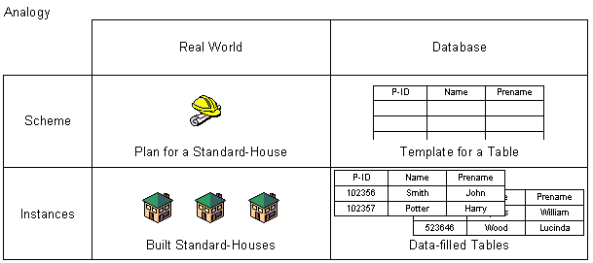
Instance or Database State
The data stored in database at a particular moment of time is called instance or state of database.
Every update operation changes the database from one state to another.
The Schema is sometimes is called the intension, and the database state an extension of the schema.

Slide 15
Three Schema Architecture
There are three levels of schema.
Confirmed by American National Standard Institute and Standard Planning and Requirement Committee
Also called ANSI/SPARC three level architecture

Slide 16
Three Schema Architecture
The goal of the three-schema architecture, is to separate the user applications from the physical database.
Internal Level Schema:
describes the physical storage structure of the database.
The internal schema uses a physical data model and describes the complete details of data storage and access paths for the database.
Conceptual Level Schema:
Describes the structure of the whole database for a community of users.
Hides the details of physical storage structures and concentrates on describing entities, data types, relationships, user operations, and constraints.
A representational data model is used to describe the conceptual schema when a database system is implemented.

Slide 17
Three Schema Architecture
External Level Schema:
includes a number of external schemas or user views.
Each external schema describes the part of the database that a particular user group is interested in and hides the rest of the database from that user group.
Each external schema is typically implemented using a representational data model, possibly based on an external schema design in a high-level data model.
Mapping: The processes of transforming requests and results between levels are called mappings.
Notes:
In the three-schema architecture, each user group refers to its own external schema. Hence, the DBMS must transform a request specified on an external schema into a request against the conceptual schema, and then into a request on the internal schema for processing over the stored database. If the request is a database retrieval, the data extracted from the stored database must be reformatted to match the user’s external view. The processes of transforming requests and results between levels are called mappings.

Slide 18
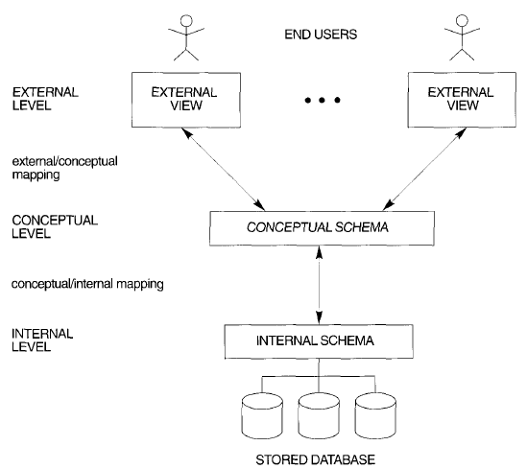
Three Schema Architecture

Slide 19
QUIZ TOMORROW 02-FEB-2024

